Slide 1
Attention is all you need

Slide 2

Contents
#1
Introduction
#2
Architecture
#3
Word Embedding
#4
Self-Attention
#5
Positional Encoding
#6
Process
#7
Conclusion

Slide 3
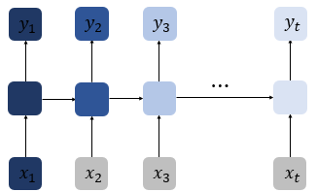
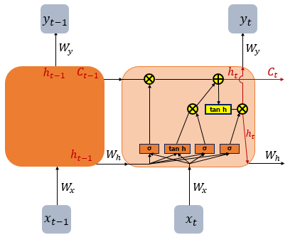
Introduction
RNN, Recurrent Neural Network
LSTM, Long Short-Term Memory

Slide 4
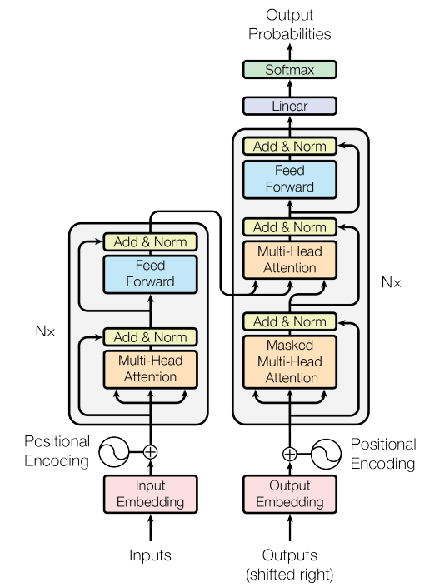
Architecture
Decoder
Encoder
Feed Forward
Multi-Head Attention
(Encoder-Decoder Attention)
Feed Forward
Multi-Head Attention
(Self-Attention)
Masked Multi-Head Attention
(Masked Self-Attention)

Slide 5
Architecture

Slide 6
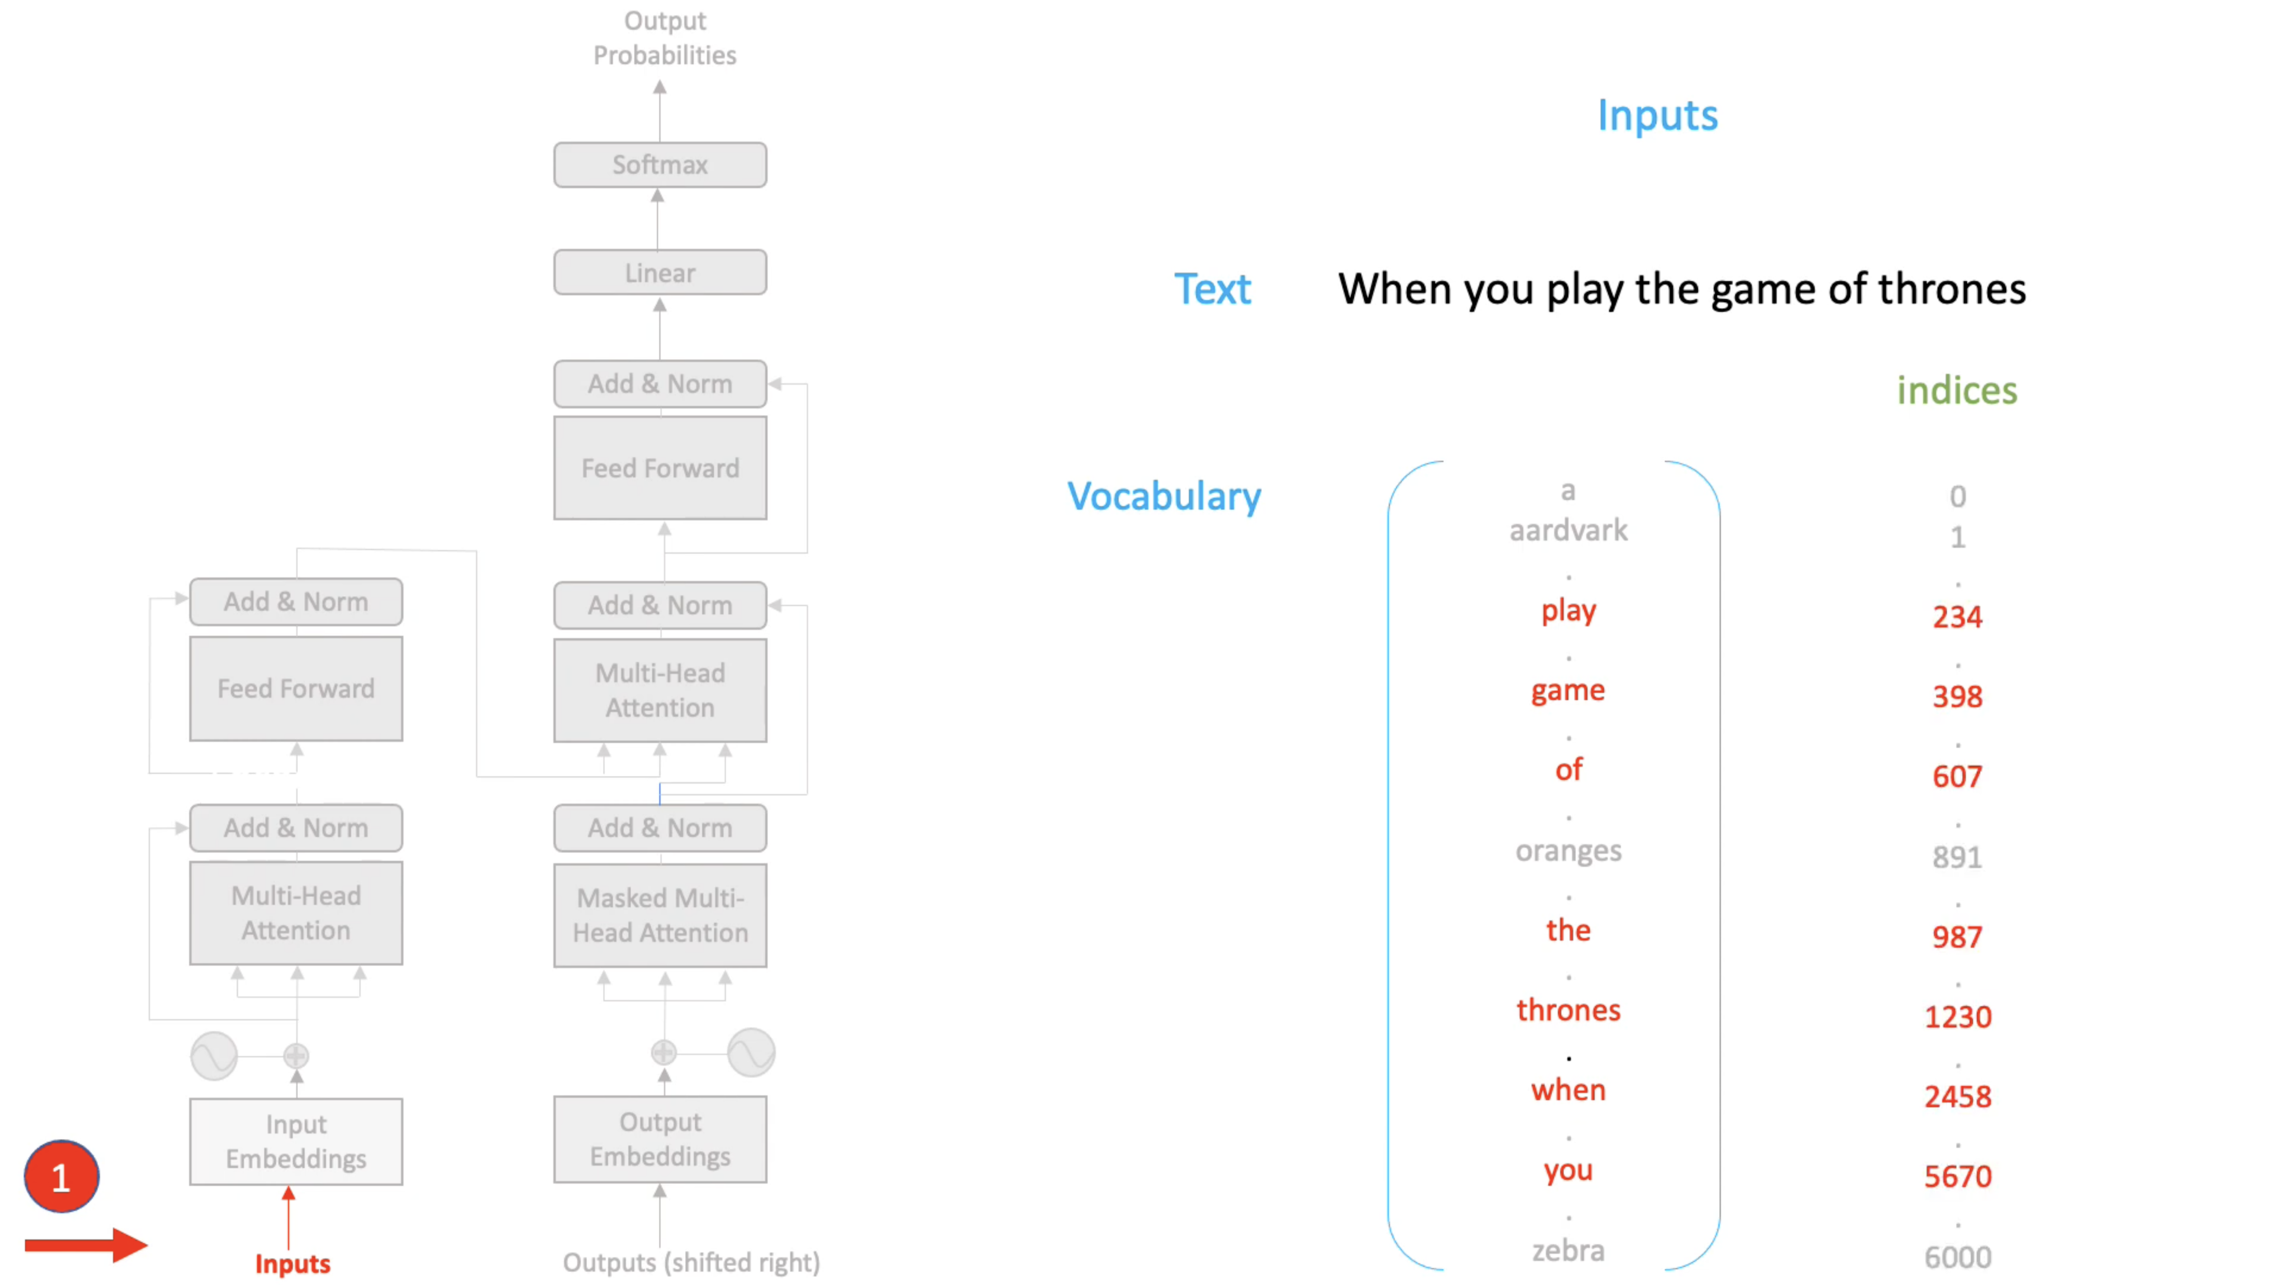
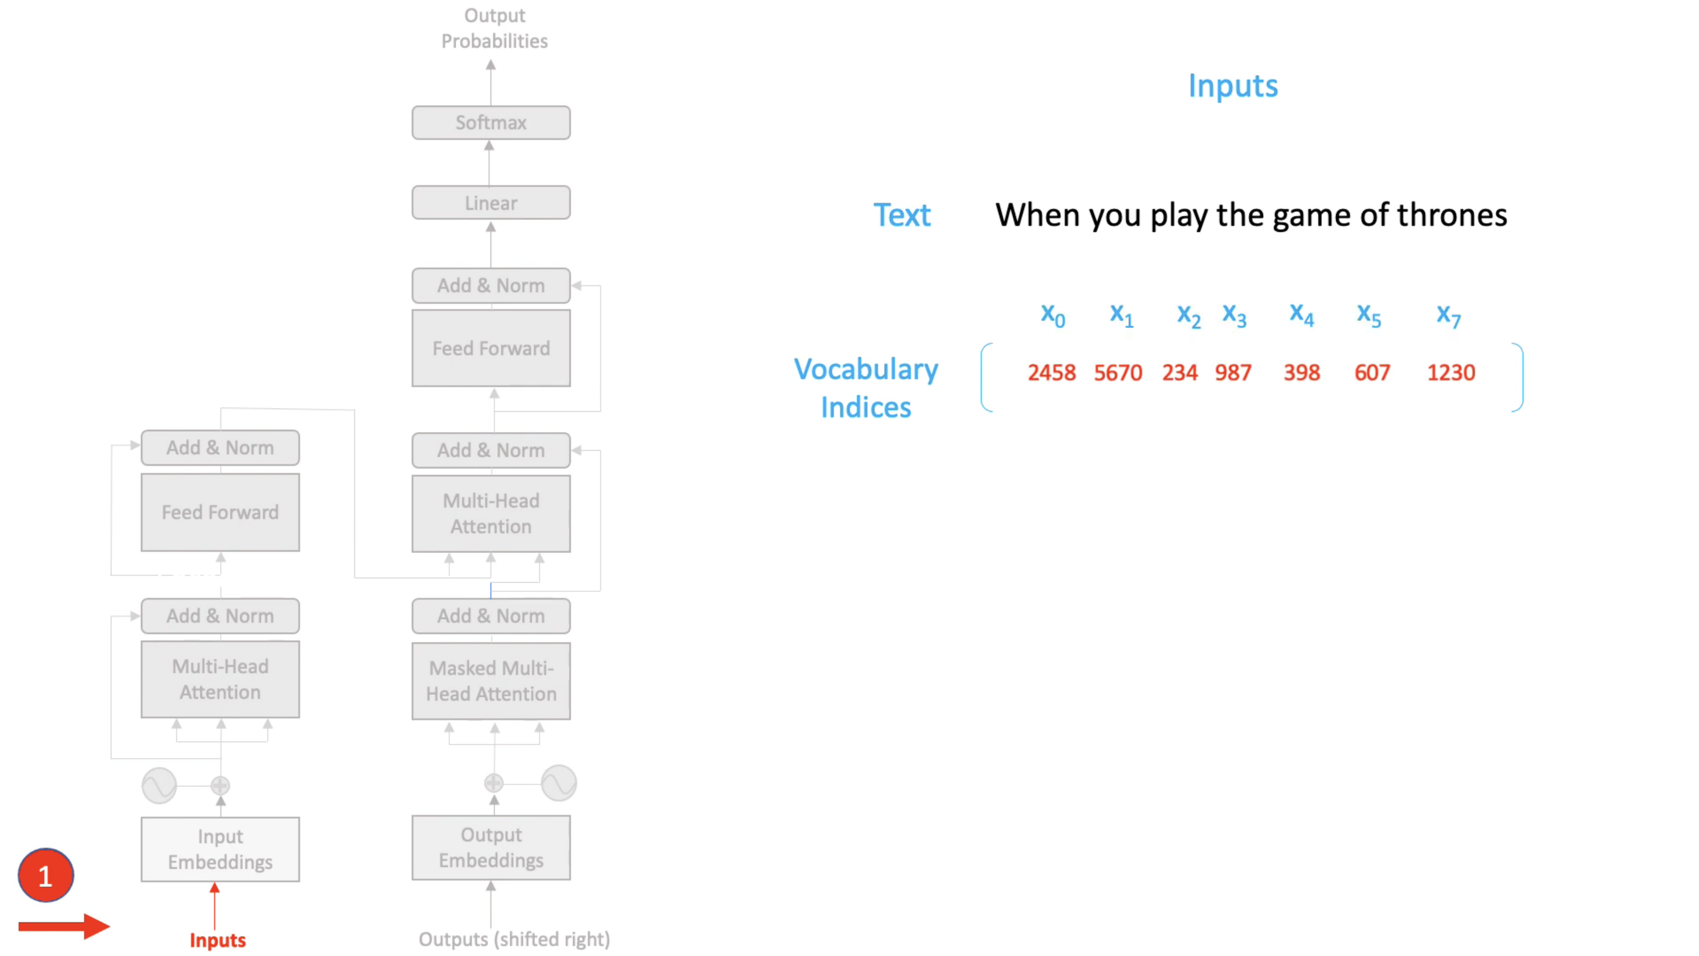


Word Embedding

Slide 7
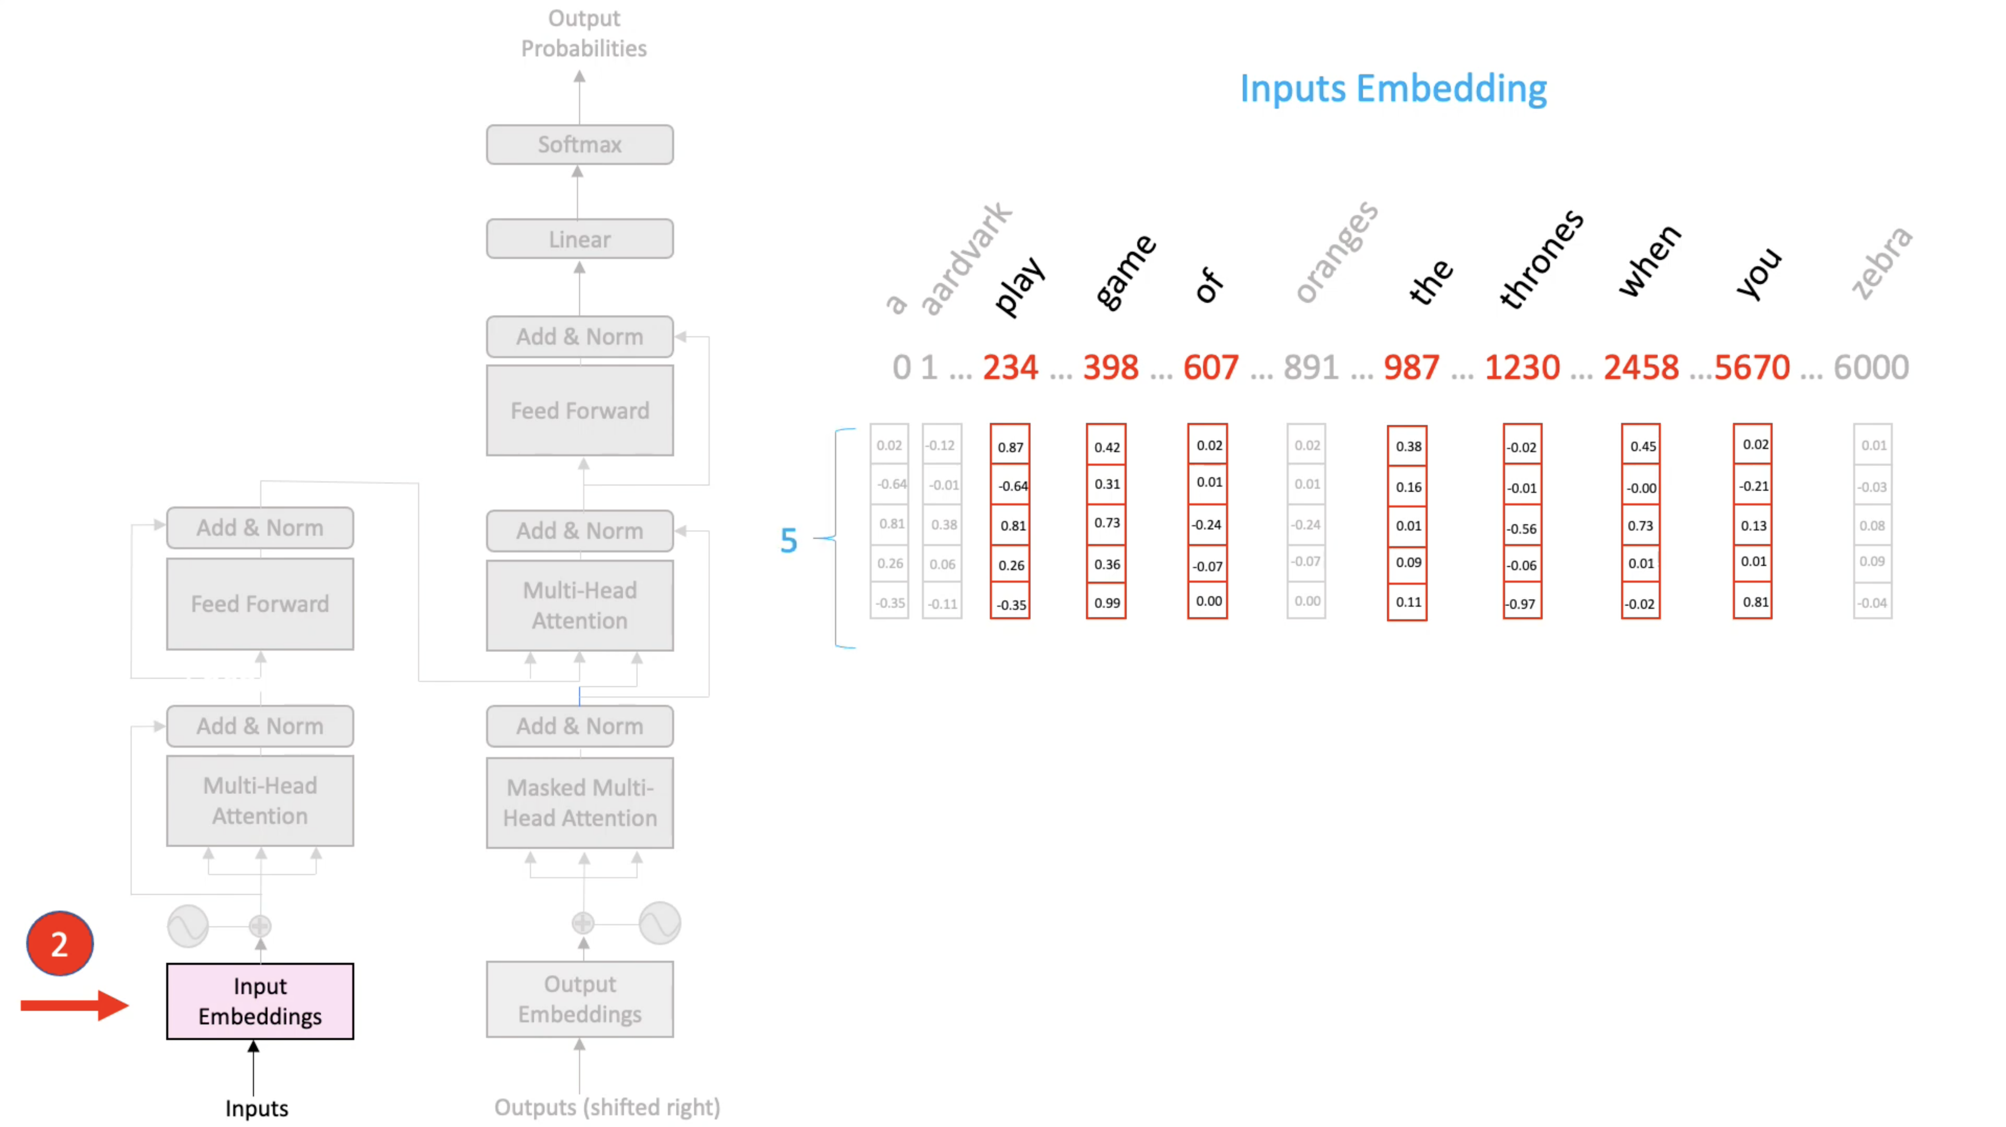

Word Embedding

Slide 8
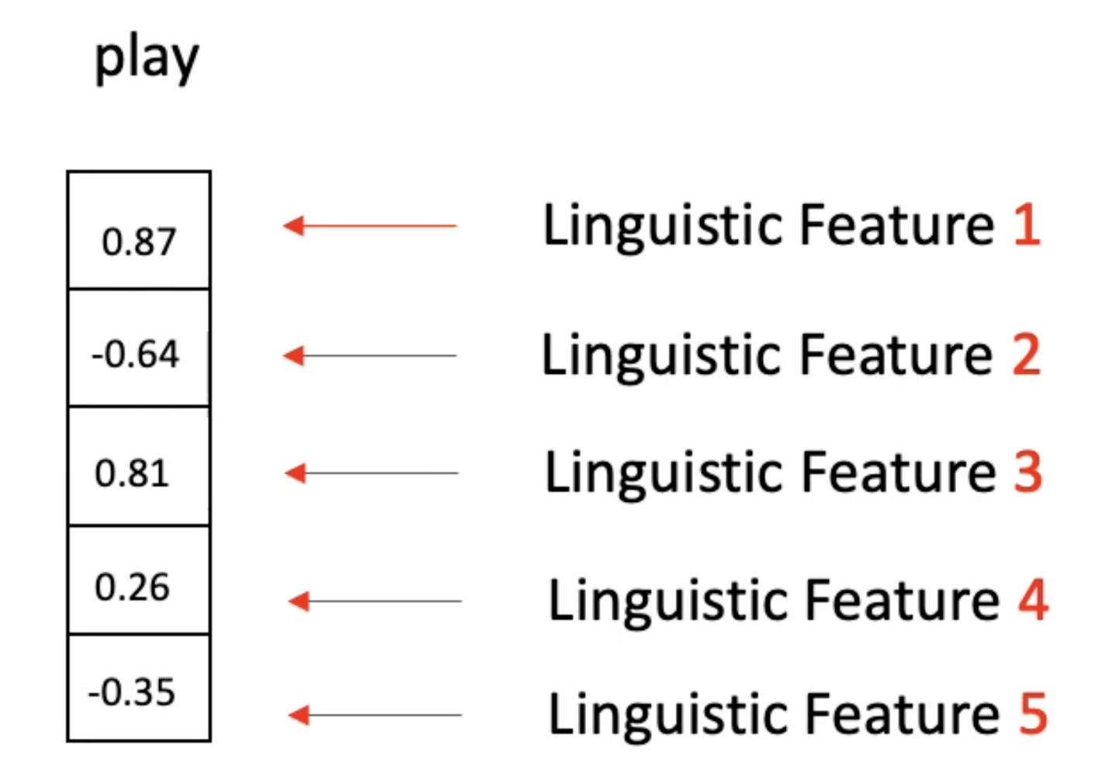
Word Embedding

Slide 9
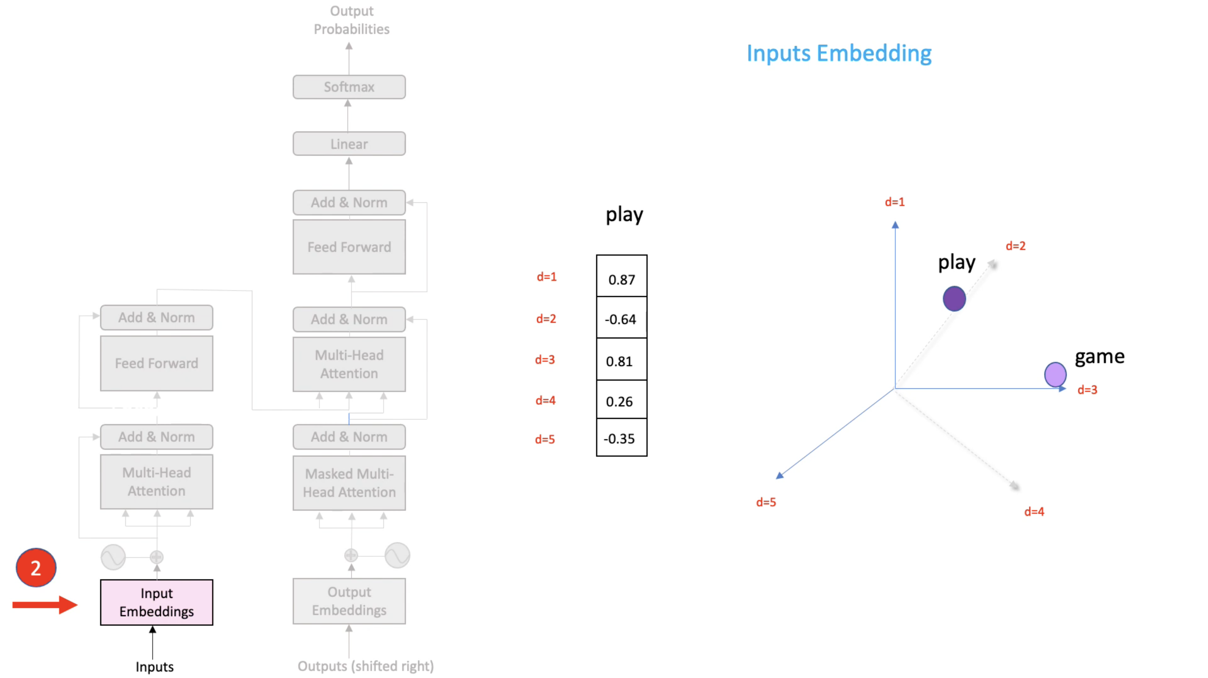
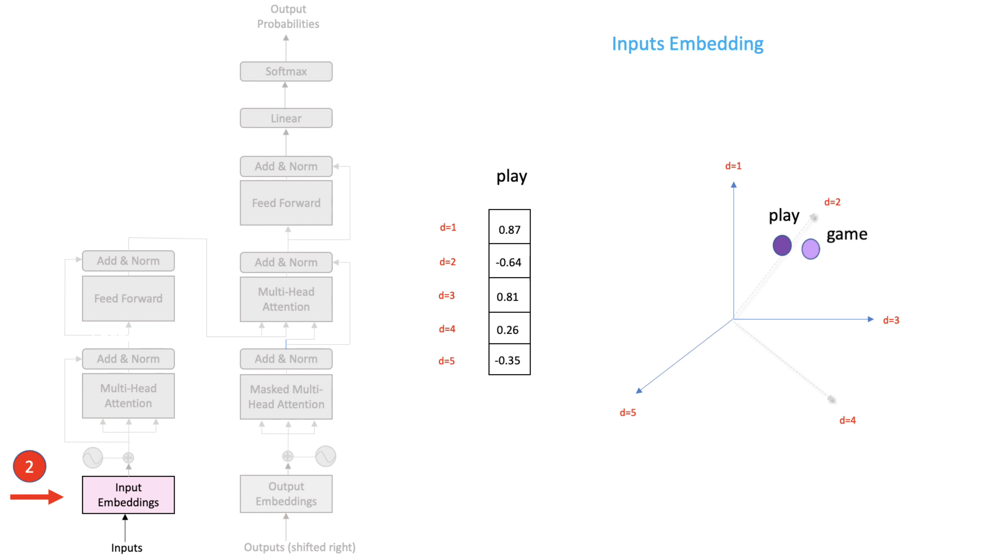
Word Embedding

Slide 10
Positional Encoding
“ Even though she did not win the award, she was satisfied ”
VS
“ Even though she did win the award, she was not satisfied ”

Slide 11
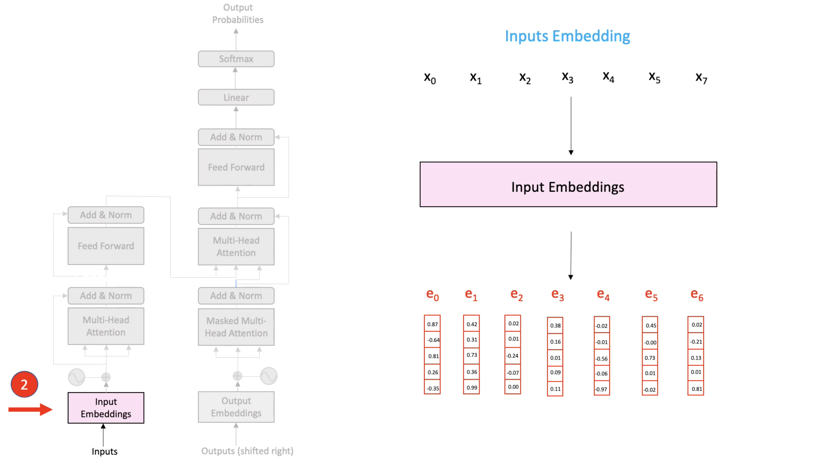

Positional Encoding

Slide 12
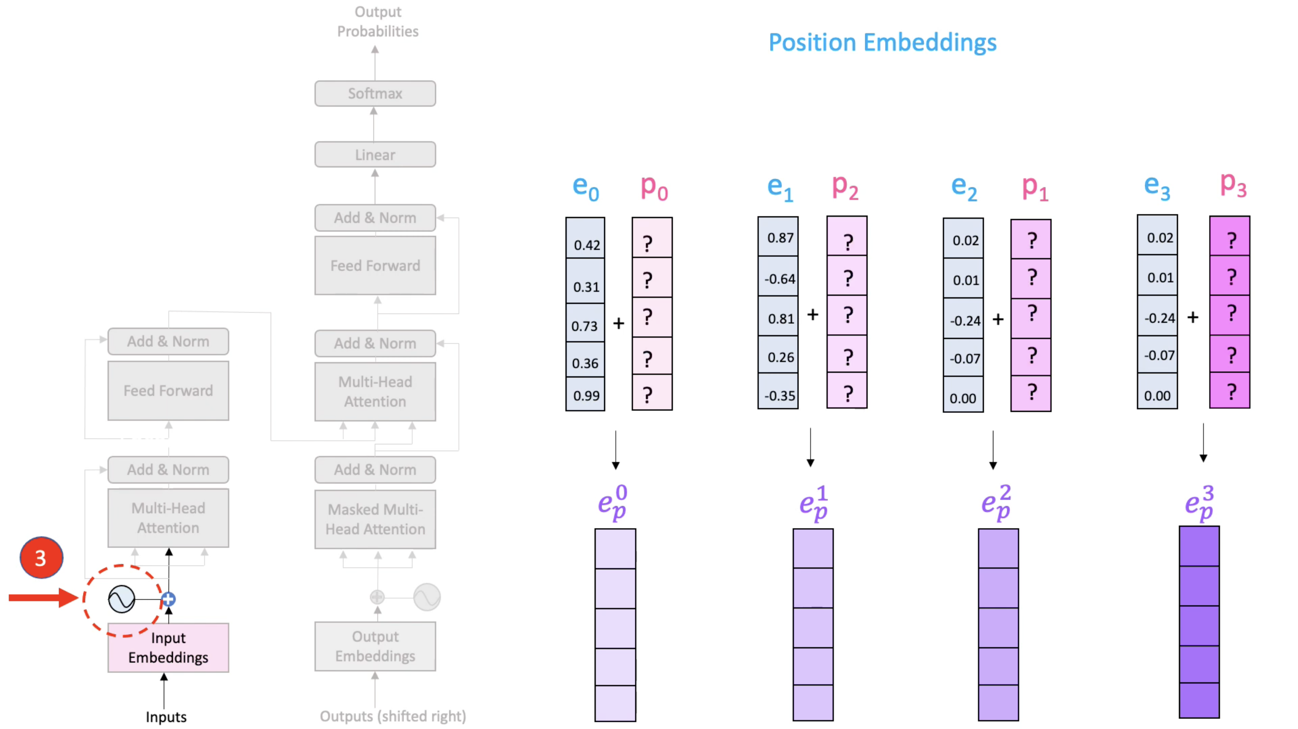

Positional Encoding

Slide 13
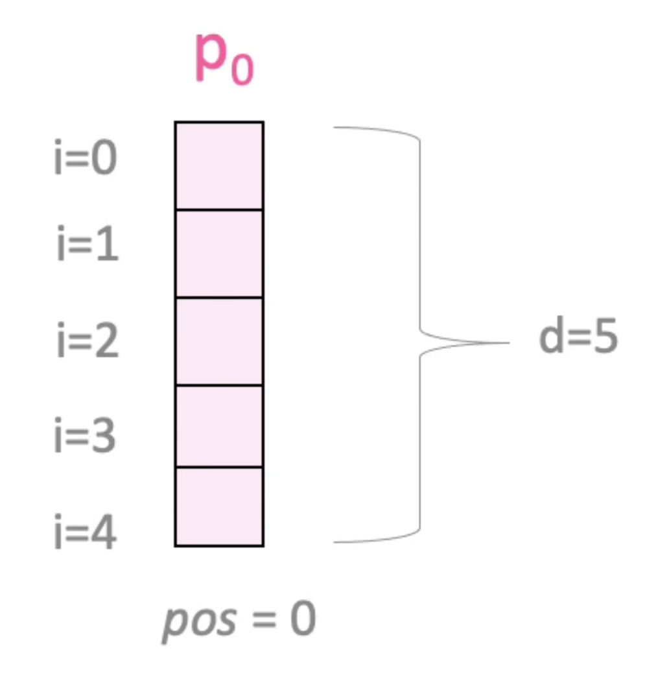
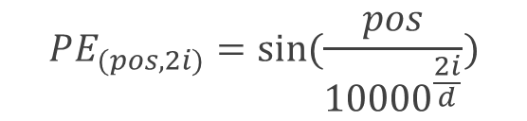
Positional Encoding
$$PE_{(pos,2i)}=\sin{(\frac{pos}{{10000}^{\frac{2i}{d}}})}$$

Slide 14
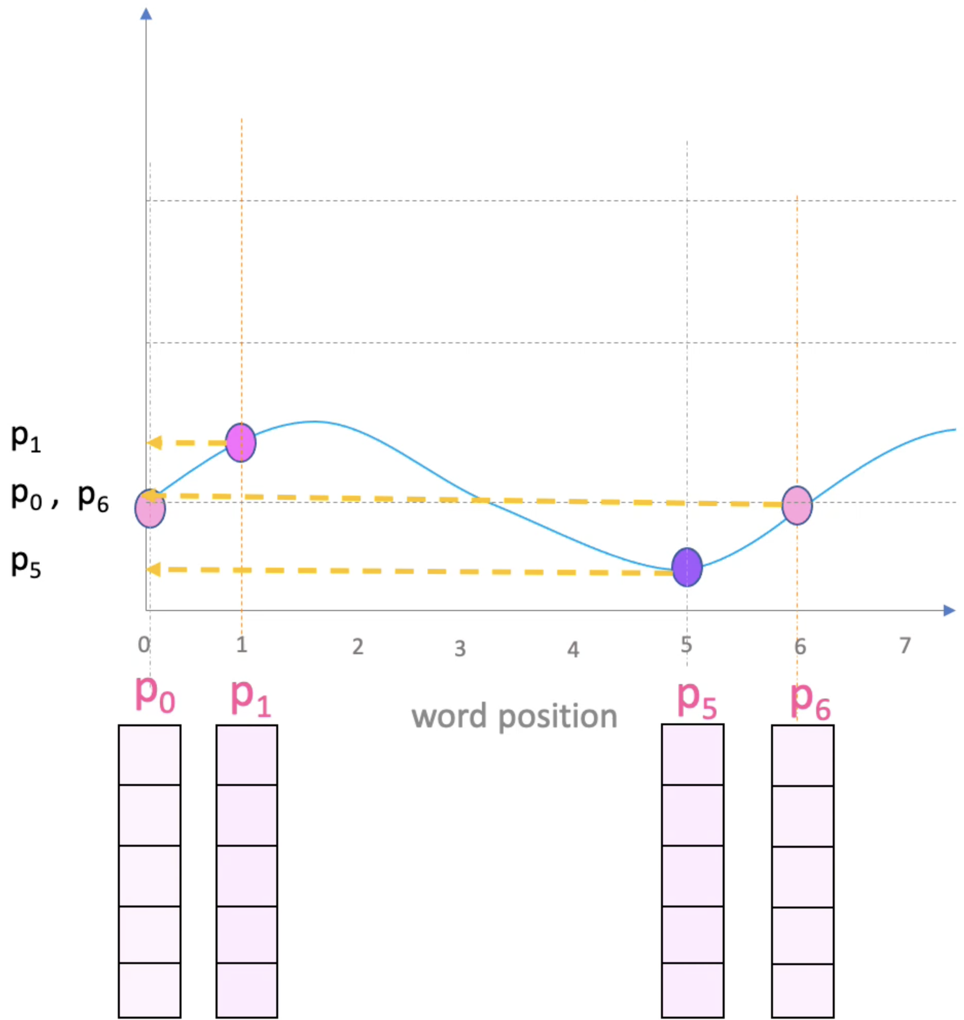
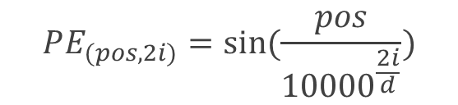

Positional Encoding
$$PE_{(pos,2i)}=\sin{(\frac{pos}{{10000}^{\frac{2i}{d}}})}$$
$$pos$$

Slide 15
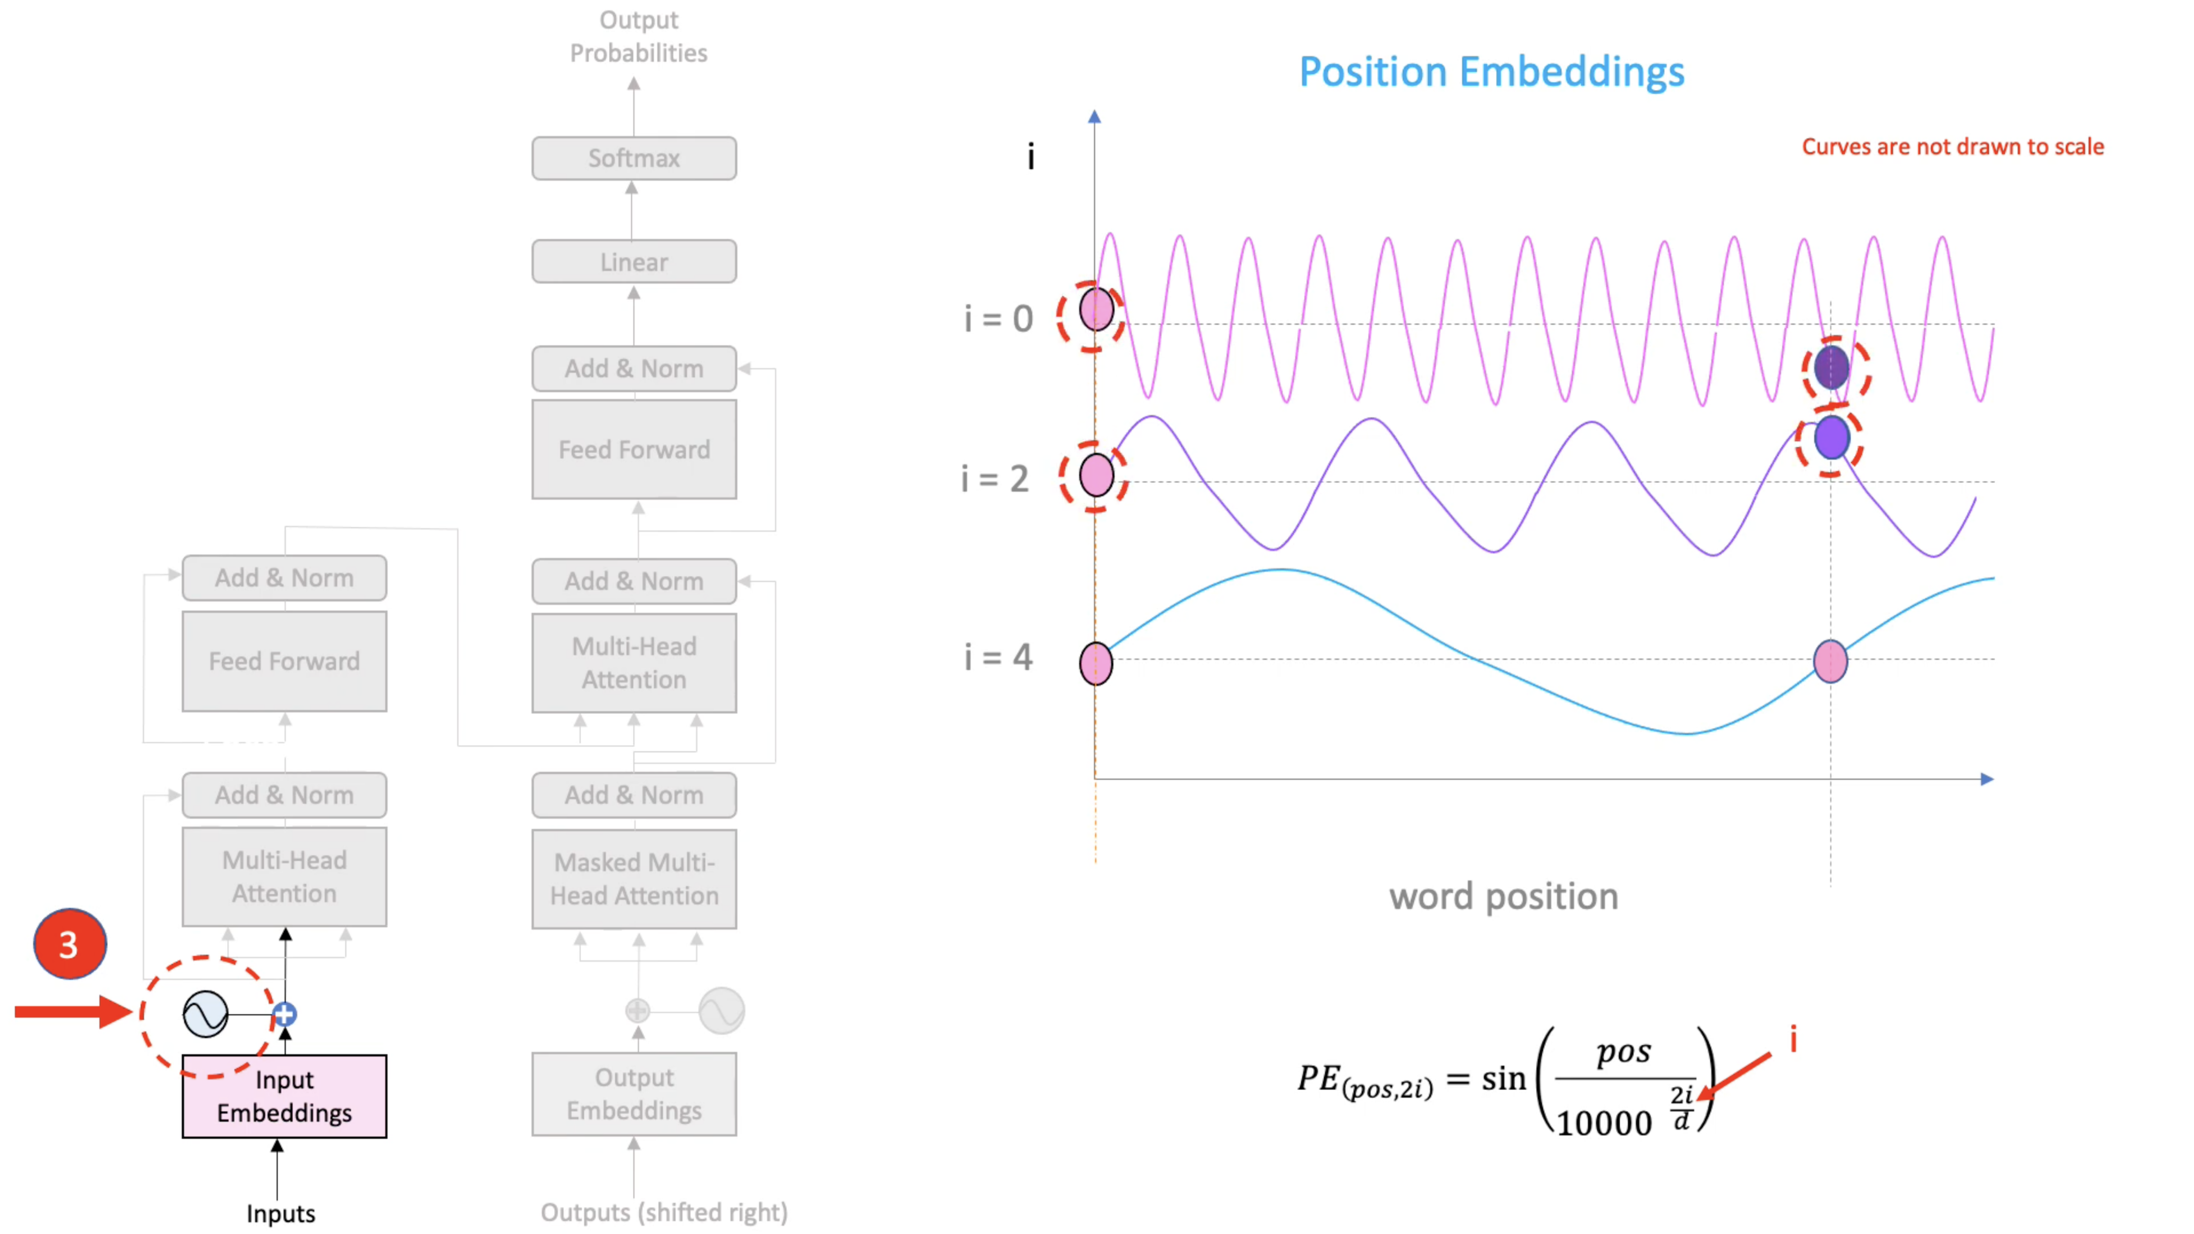
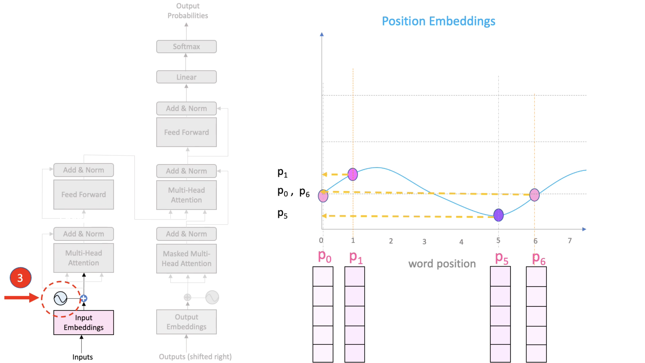
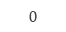
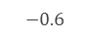
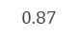

Positional Encoding
$$PE_{(pos,2i)}=\sin{(\frac{pos}{{10000}^{\frac{2i}{d}}})}$$
$$pos$$
$$0$$
$$−0.6$$
$$0$$
$$0.87$$
$$0$$
$$0$$

Slide 16
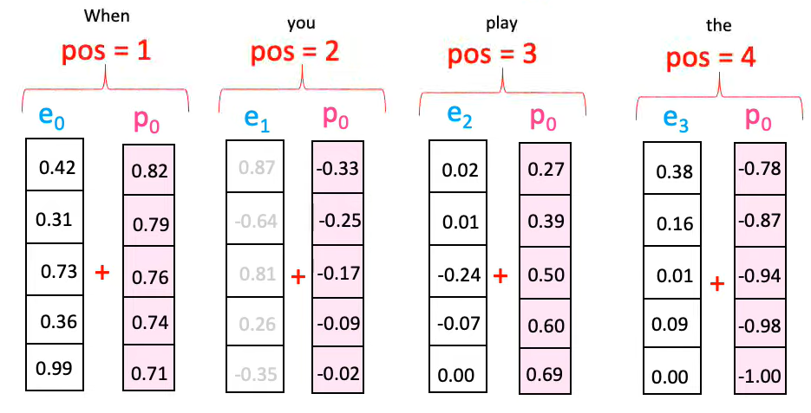
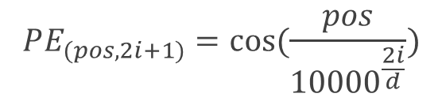


Positional Encoding
$$…$$
$$PE_{(pos,2i)}=\sin{(\frac{pos}{{10000}^{\frac{2i}{d}}})}$$
$$PE_{(pos,2i+1)}=\cos{(\frac{pos}{{10000}^{\frac{2i}{d}}})}$$

Slide 17
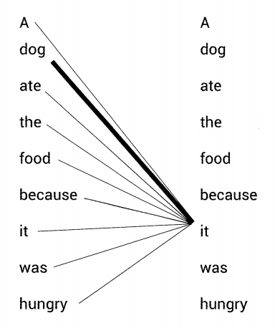
Self-Attention
“ A dog ate the food because it was hungry ”
Self-Attention?
Connection

Slide 18
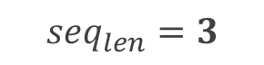
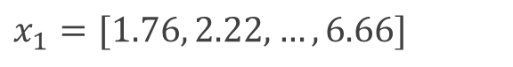
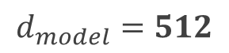
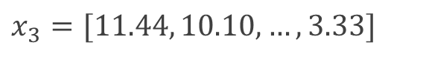
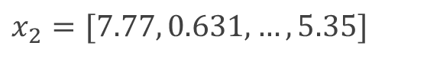
Self-Attention
“ I am good ”
I
$$x_{1}=[1.76, 2.22, …, 6.66]$$
$${seq}_{len}=3$$
am
$$x_{2}=[7.77, 0.631, …, 5.35]$$
good
$$x_{3}=[11.44, 10.10, …, 3.33]$$
$$d_{model}=512$$

Slide 19
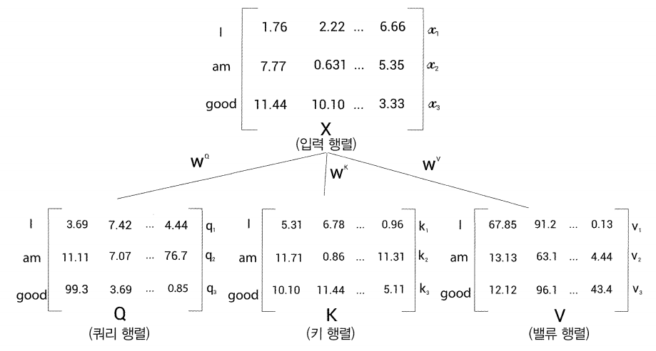
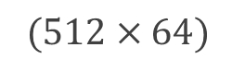

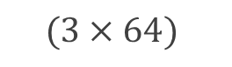
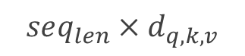

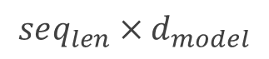
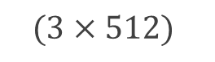
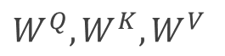
Self-Attention
Shape of Matrix
$$X$$
$$(3×512)$$
$$seq_{len}×d_{model}$$
Input
Weight
$$W^{Q}, W^{K}, W^{V}$$
$$(512×64)$$
Query
Key
Value
$$Q, K, V$$
$$(3×64)$$
$$seq_{len}×d_{q,k,v}$$

Slide 20
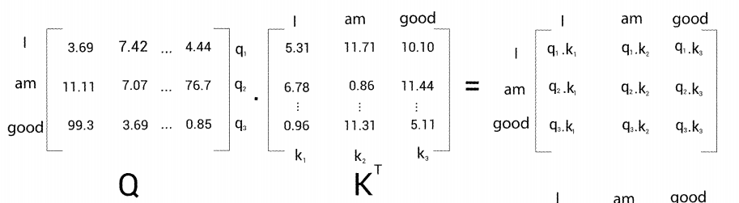
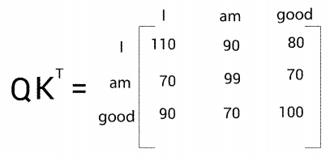

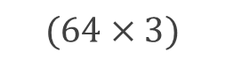
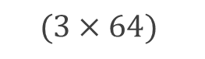
Self-Attention
1. $Q∙K^{T}$ (Inner product of $Query$ and $Key$ matrix)
$$(3×64)$$
$$(64×3)$$
$$(3×3)$$

Slide 21
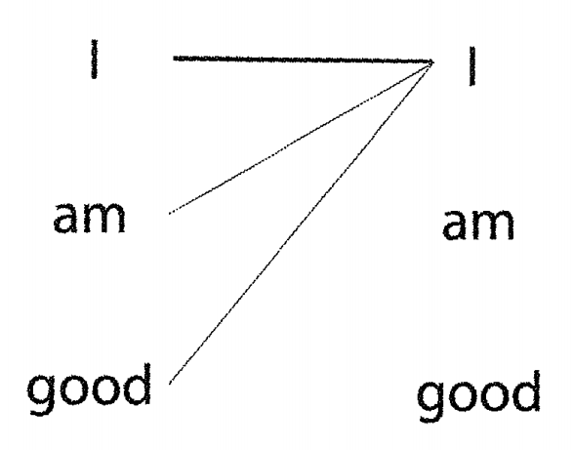
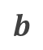



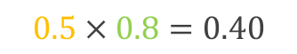
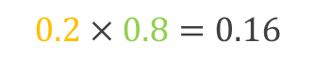
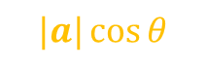
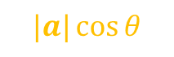

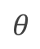
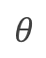
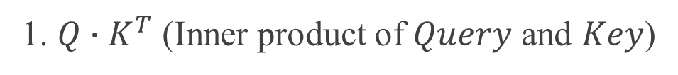
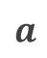
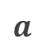
Self-Attention
1. $Q∙K^{T}$ (Inner product of $Query$ and $Key$)
Calculating the inner product between two vectors
shows how similar the two vectors are.
Inner product $a∙b=|a||b|\cos{θ}$
$$a$$
$$a$$
$$θ$$
$$θ$$
$$b$$
$$b$$
$$|a|\cos{θ}$$
$$|b|$$
$$|a|\cos{θ}$$
$$|b|$$
$$0.2×0.8=0.16$$
$$0.5×0.8=0.40$$

Slide 22

Self-Attention
1. $Q∙K^{T}$ (Inner product of $Query$ and $Key$ matrix)
$$(3×64)$$
$$(64×3)$$
$$(3×3)$$

Slide 23




Self-Attention
2. $\frac{Q⋅K^{T}}{\sqrt{d_{k}}}$ (Divide by $\sqrt{d_{k}}$)
$d_{k}$: dimension of the $Key$ vector
To obtain a stable
gradient value

Slide 24



Self-Attention
3. $Softmax(\frac{Q⋅K^{T}}{\sqrt{d_{k}}})$ (Apply $Softmax$)
unnormalized
→ normalized
$$Softmax\left(z\right)=\frac{e^{z_{i}}}{\sum_{j=1}^{k}{e^{z_{j}}}}$$
Score matrix

Slide 25





Self-Attention
4. $Softmax\left(\frac{Q⋅K^{T}}{\sqrt{d_{k}}}\right)V$ (Multiply $Value$ matrix)
$$(3×3)$$
$$(3×64)$$
Attention matrix
$$(3×64)$$

Slide 26












Self-Attention
Multi-head Attention
$$Z_{1}=softmax\left(\frac{Q_{1}K_{1}^{T}}{\sqrt{d_{k}}}\right)V_{1}$$
$$(3×64)$$
$$Z_{2}=softmax\left(\frac{Q_{2}K_{2}^{T}}{\sqrt{d_{k}}}\right)V_{2}$$
$$(3×64)$$
Concatenate
$$…$$
$${num}_{heads}=8$$
$$Z_{8}=softmax\left(\frac{Q_{8}K_{8}^{T}}{\sqrt{d_{k}}}\right)V_{8}$$
$$(3×64)$$
$$(Z_{1}, Z_{2}, …, Z_{8})$$
$$W_{O}$$
$$(3×512)$$
weight matrix of output
$$64×8$$

Slide 27






Add & Norm
Residual Connection
Layer Normalization
$$H\left(x\right)=x+F(x)$$
$${\hat{x}}_{i,k}=\frac{x_{i,k}−μ_{i}}{\sqrt{σ_{i}^{2}+ε}}$$
$$(seq_{len}, d_{model})$$
$$\ln_{i}{γ{\hat{x}}_{i}+β=LayerNorm(x_{i})}$$

Slide 28

Feed Forward
$$FFNN\left(x\right)=MAX\left(0, xW_{1}+b_{1}\right)W_{2}+b_{2}$$

Slide 29
Architecture
Representation
Je vais bien <eos>
Encoder #6
Decoder #6
Encoder #5
Decoder #5
Encoder #4
Decoder #4
Encoder #3
Decoder #3
Encoder #2
Decoder #2
Encoder #1
Decoder #1
I am good
<sos> Je vais bien

Slide 30


Decoder - Look-ahead Mask
Masking

Slide 31

Decoder - Encoder-Decoder Attention
from Decoder
from Encoder
Attention Matrix
Representation
Query matrix
Key matrix
Value matrix

Slide 32
Decoder
Representation
Je vais bien <eos>
Encoder #6
Decoder #6
Encoder #5
Decoder #5
Encoder #4
Decoder #4
Encoder #3
Decoder #3
Encoder #2
Decoder #2
Encoder #1
Decoder #1
I am good
<sos> Je vais bien

Slide 33
Thank you

